Slide 1
METASTACK
Made by Bug Busters!

Slide 2
TEAM MEMBERS
Aayush Chauhan
Adarsh Moradiya
Aditya Chavda
Ankur Makwana
Dhrumil Dalwadi
Divyang Parmar
Happy Makadiya
Janak Mistry
Manoj Padiya
Pradip Prajapati
Vivek Chavda
Yatharth Andharia

Slide 3
Overview
The main objective of our hack is to create a platform to ask questions regarding your problem and the community provides the solution.
If anyone finds any answer helpful and solves their problem, they can send Crypto Tokens as appreciation!
Our Team was divided to work on the following tasks:
Designing and Creating Frontend
Database Design and API Creation
Smart Contract Development and Testing

Slide 4
Technologies Used
Backend
02
Frontend
01
Blockchain
03
MongoDB
Node JS
Express JS
Postman
Flutter
Dart
Ethereum
Solidity
Infura

Slide 5
APPLICATION FLOW

Slide 6
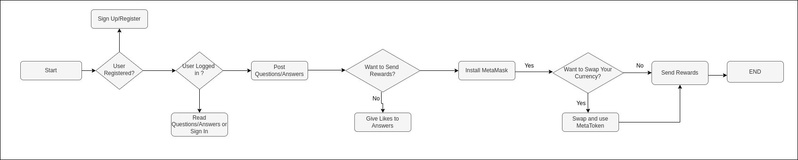

Slide 7
FEW SNAPSHOTS...

Slide 8
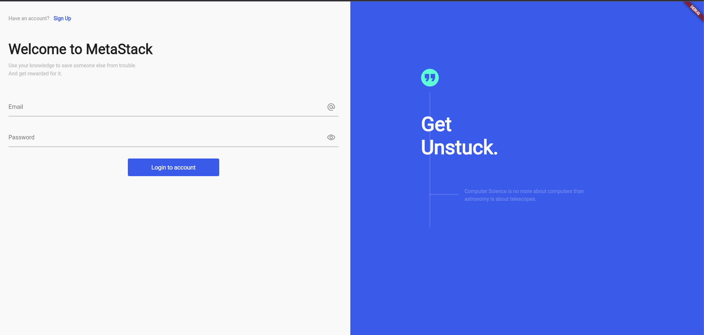
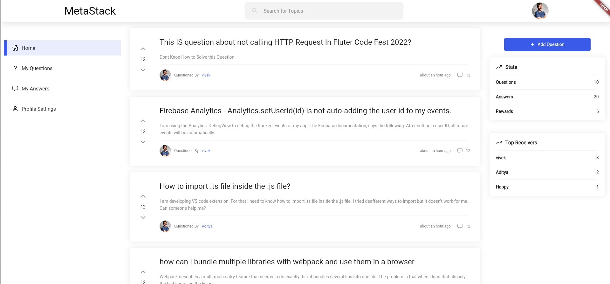
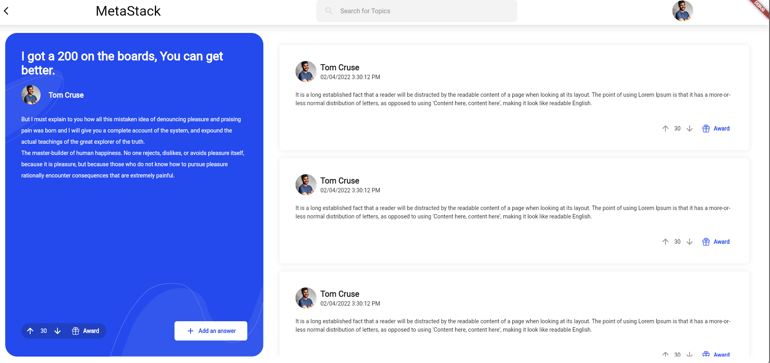

Slide 9
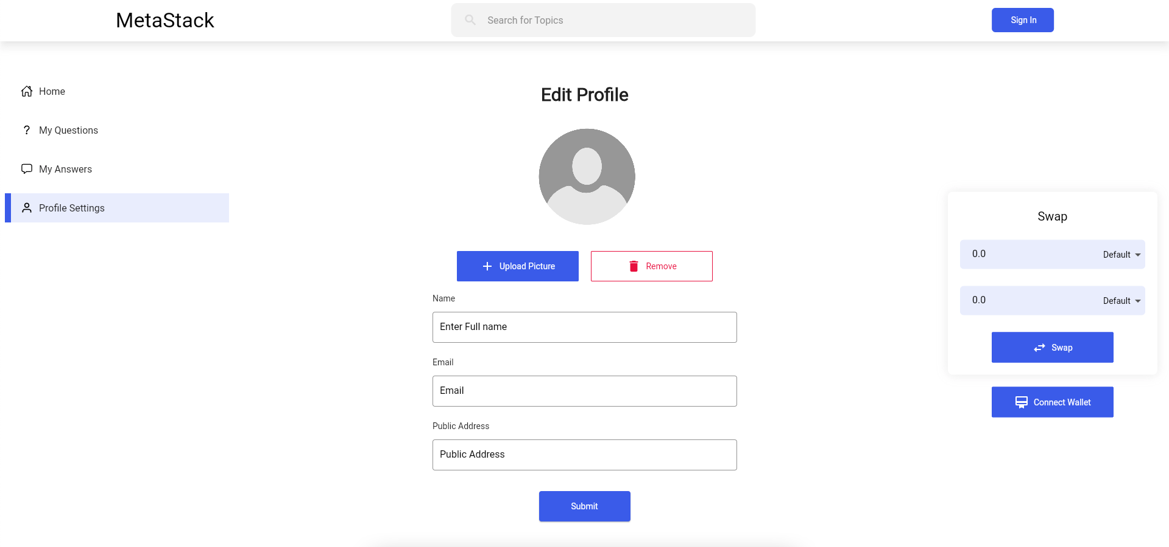
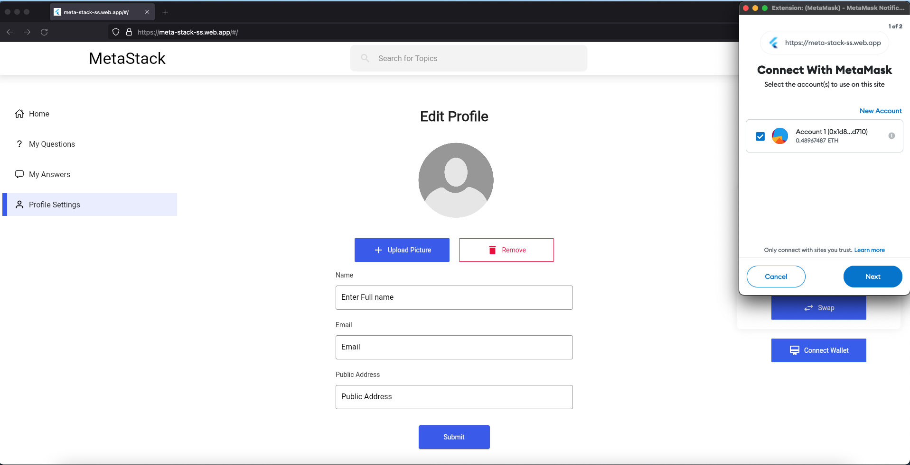
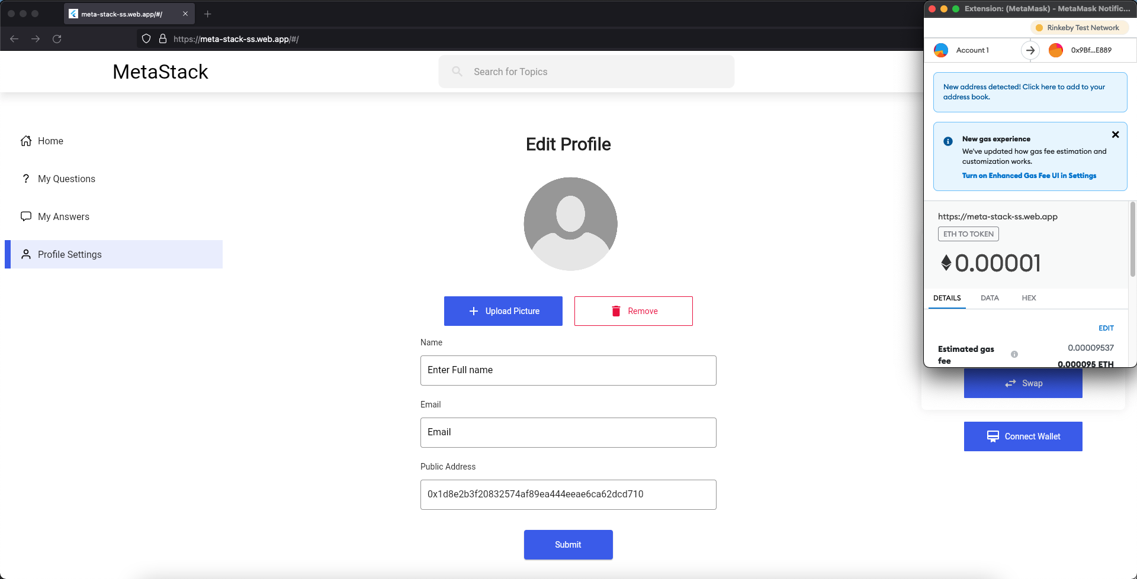

Slide 10
THANK YOU!

Slide 11
POSSIBLE FUTURE ENHANCEMENTS
More Token options can be added for rewards.
Rewards can be sent to answers reaching certain number of upvotes.
Few percentage of transactions can be taken as commission Fee.
Your Ideas?

